Slide 1
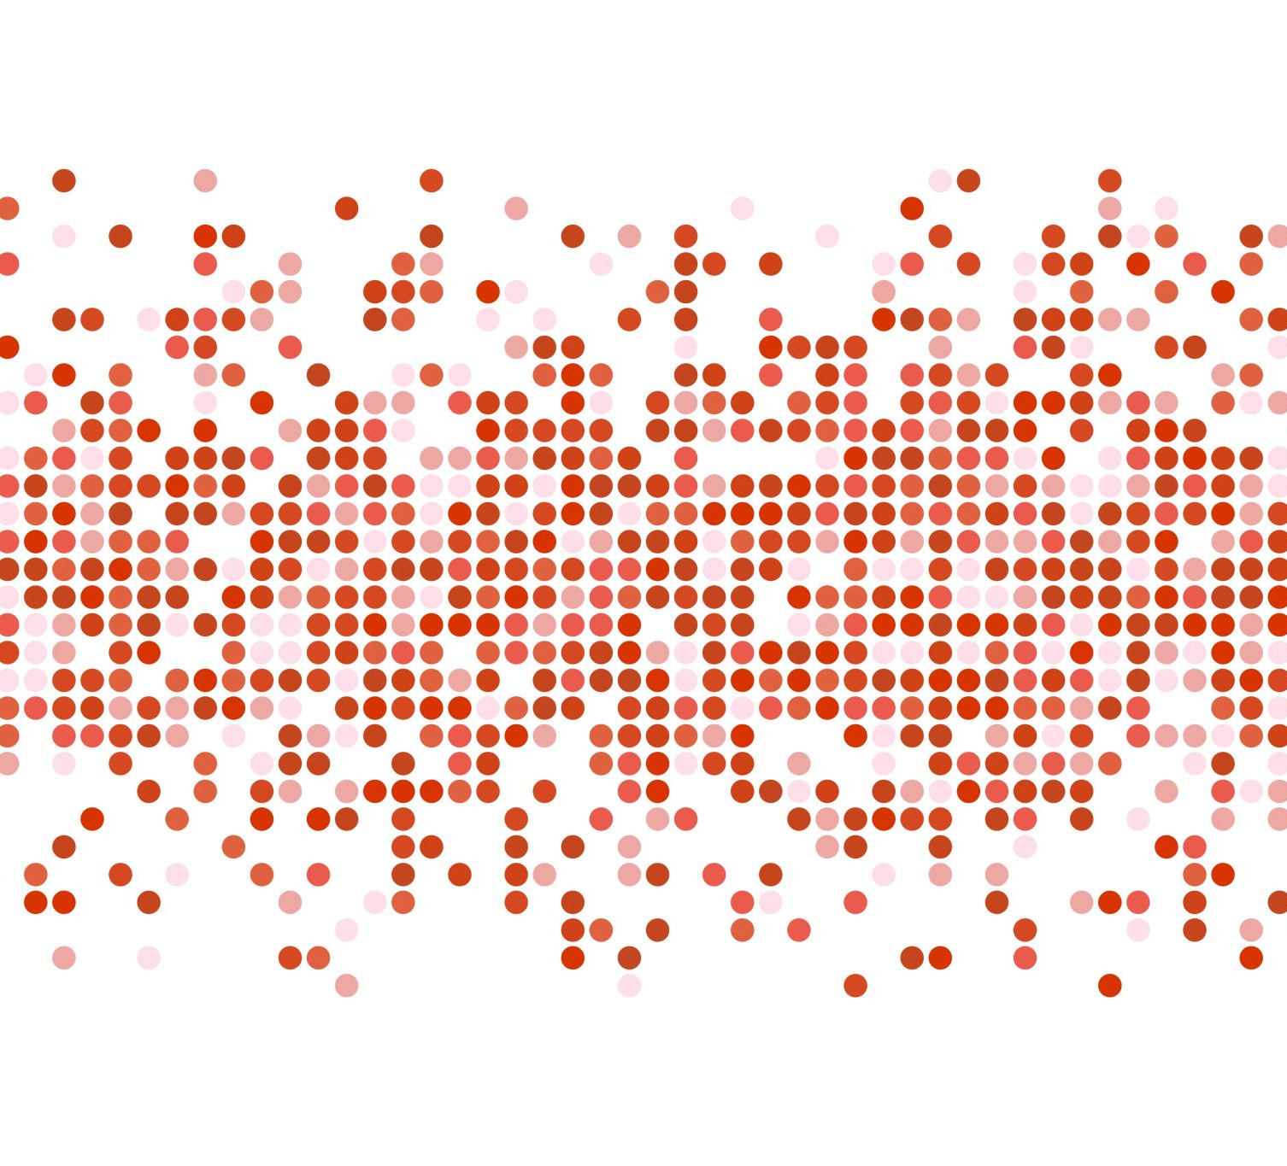
State of Victoria’s Crime Data Visualisation pre-COVID and during COVID
Berta Devenyi Phuong Tieu

Slide 2
Objectives of the Study
Data Exploration
In Victoria in high level, we have 4 Police Regions, plus Justice Institutions and Immigration Facilities and Unincorporated Vic. Each Police Region has multiple Police Service Area (PSA, total of 54) which provide law and order services to Local Government Area (LGA, total of 79) . Each offence can break down to division, sub-division and sub-group. Each year the Victoria Crime Statistic data were released in March.
Compare the last 4 years of crime offences in Victoria, 2019-2022, pre-COVID and during COVID.
Explore crime and safety status in different Local Government Areas (LGAs).
Compare the 10 most committed crimes against people in different LGAs in 2019, 2020 & 2021.
Filtering offence data by Year and LGA and visualizing this data.
Source: https://www.crimestatistics.vic.gov.au/about-the-data/glossary-and-data-dictionary

Slide 3
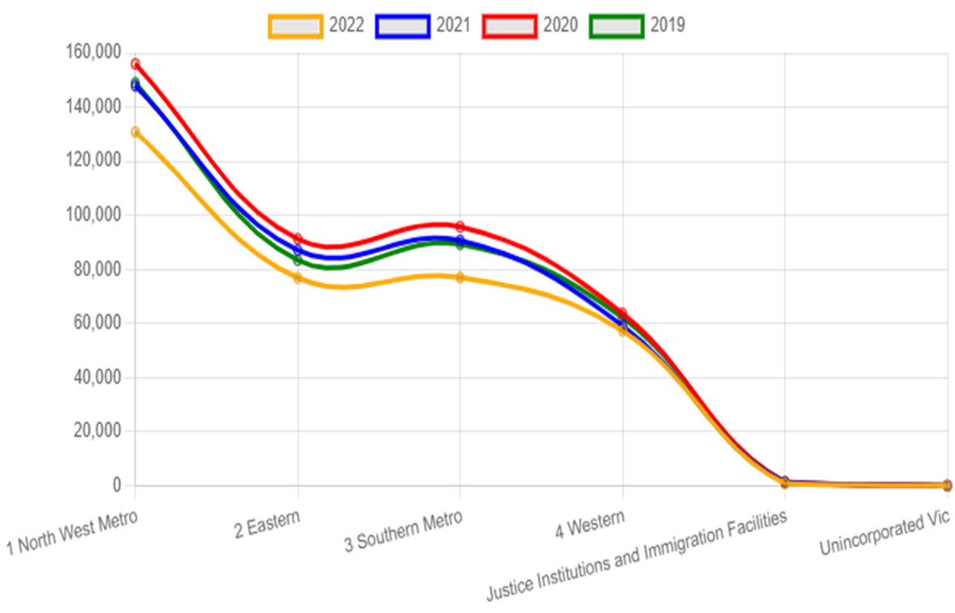
Regional Offences 2019-2022
Data Analysis This line chart shows 4 years of Victoria’s offence data. 2020 had the highest offence counts, follow to it was 2021 and 2019. The number of offences are lowest in 2022.
Technical background This line chart was created using chartjs. When the chart first load, tension setting will the line soften, it has delay animation effect. Upon clicking on the year labels will toggle hide or show the line of that year.
Hover over a data point will show region’s name and offence count.

Slide 4
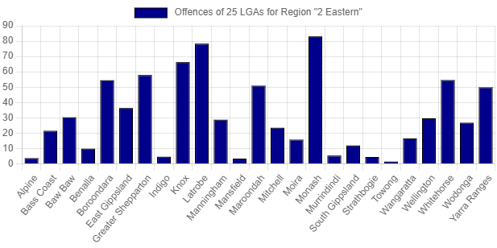
Data Analysis In 2022, in Police Region ‘2 Eastern’, among the 25 LGAs, Monash had the highest number of offences; next to it were Latrobe and Knox. Technical background: This bar chart was created using chart js. When the chart first load, it has delay animation effect. Upon clicking on the label ‘Local Government Offence’ will toggle hide or show the chart. Hover over a bar will show LGA’s name and its incident count.
Local Government Area Offences base on Police Region

Slide 5
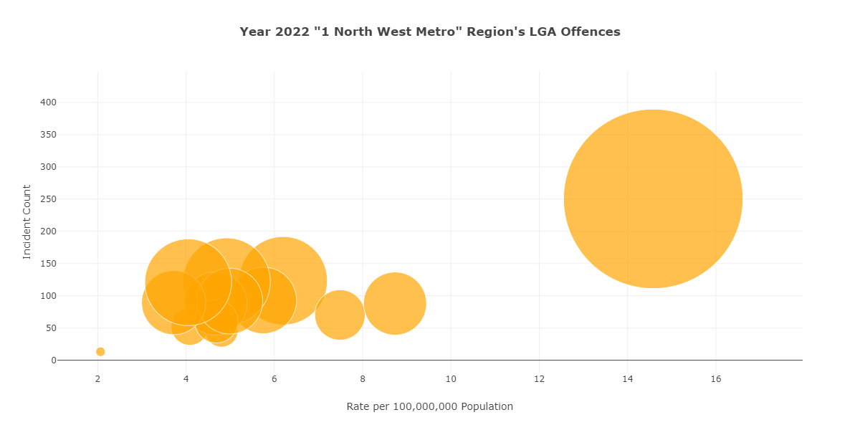
Data Analysis In 2022, in Police Region ‘1 North West Metro’, among the 14 LGAs, Melbourne had the highest number of offences; next to it were Brimbank and Wyndham. Technical background: This bubble chart was created using plotly. Hover over a bubble will show LGA’s name and its incident count.
Regional Local Government Offences

Slide 6
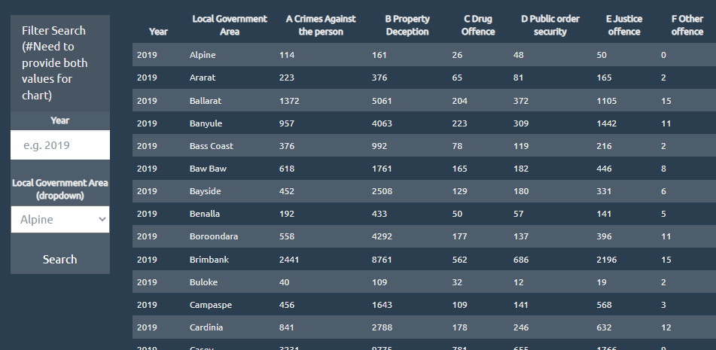
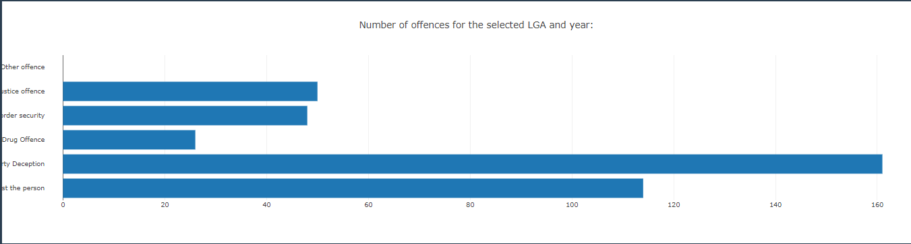
Offence Summary – List, Filter, Chart
Offence Summary can be listed, filtered and charted by:
Year
Local Government Area
Offence types (A-F)
The LGA filter is populated from the data source as well (dropdown)
Filtering is possible by different fields (Local Government Area and Year)
Using the filters on the same page and Plotly, we display a bar chart representing the different offence types for a specific Local Government area for a specific year.
Technical Background:
List / Filter: Displaying the summary data loaded from CSV, using Javascript, HTML, CSS and D3 (policedata.html, policadata.js, policedata.css)
Chart: Javascript, Plotly, D3

Slide 7
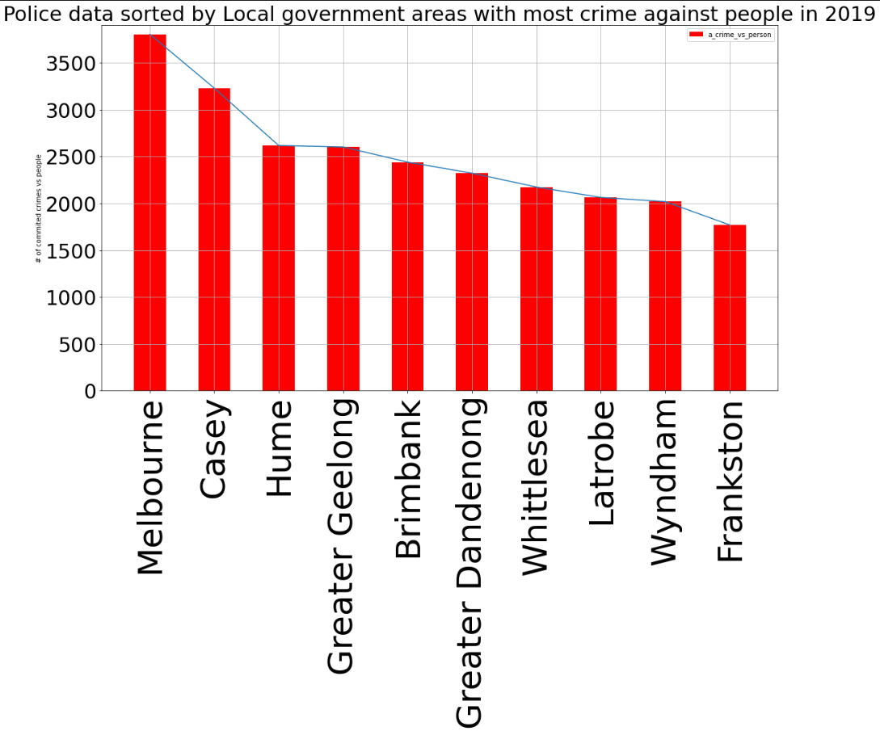

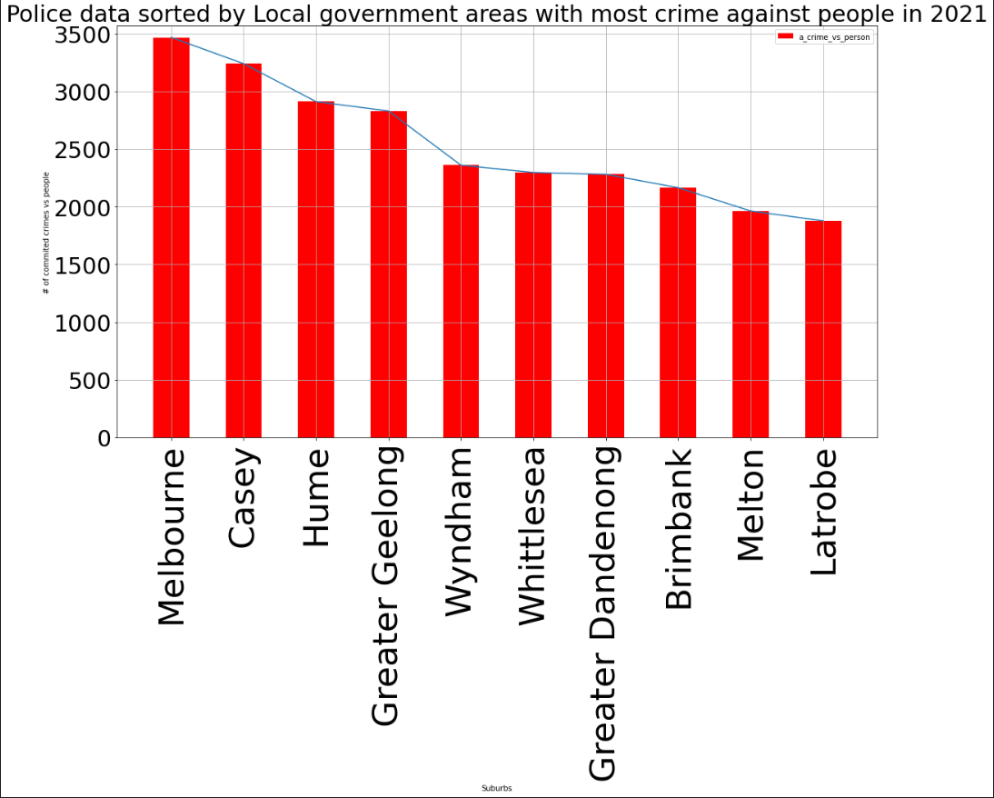
10 most committed crimes against people in different LGAs in 2019, 2020 & 2021 (Data analysis)
Technical Background: Python, Pandas, Matplotlib (policedata.ipynb)

Slide 8
Findings
In 2017 Victoria had the highest number of home theft and burglary in Australia.
If we compare individual LGAs with the highest number of crimes before COVID and during COVID, we can see that the ranking hasn’t significantly changed. The number of crimes did change, however.
The number of crimes has dropped a lot in 2022 compared to the number of crimes in 2020.

Slide 9
QUESTION
TIME

Slide 10
Thank you for your attention

